Slide 1
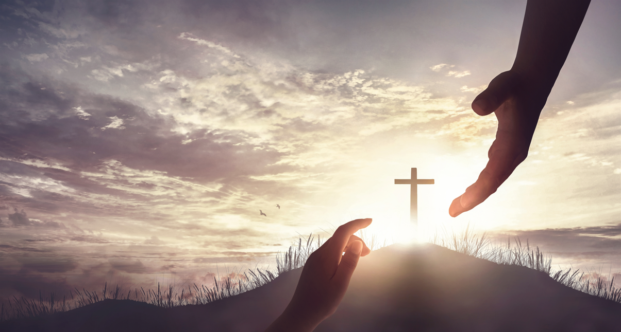
Realigning Congregational Priorities Around God’s Mission
Haggai 1:2-9
Notes:
Eddie Williams ~ October 11, 2026 (Eloy AM)
~ AZ Lectureship

Slide 2
Haggai 1:2-9 (NASB)
² Thus says the LORD of hosts, "This people says, 'The time has not come, even the time for the house of the LORD to be rebuilt.'" ³ Then the word of the LORD came by Haggai the prophet, saying, ⁴ "Is it time for you yourselves to dwell in your paneled houses while this house lies desolate?"

Slide 3
Haggai 1:2-9 (NASB)
⁵ Now therefore, thus says the LORD of hosts, "Consider your ways! ⁶ You have sown much, but harvest little; you eat, but there is not enough to be satisfied; you drink, but there is not enough to become drunk; you put on clothing, but no one is warm enough;

Slide 4
Haggai 1:2-9 (NASB)
and he who earns, earns wages to put into a purse with holes."
⁷ Thus says the LORD of hosts, "Consider your ways! ⁸ "Go up to the mountains, bring wood and rebuild the temple, that I may be pleased with it and be glorified," says the LORD.

Slide 5
Haggai 1:2-9 (NASB)
⁹ "You look for much, but behold, it comes to little; when you bring it home, I blow it away. Why?" declares the LORD of hosts, "Because of My house which lies desolate, while each of you runs to his own house.

Slide 6
The Book of Haggai, the second shortest in the Old Testament, communicates the message: Put first things first. It was written to people like us, who would say that God must be first. But they had drifted away from this truth. They lived with misplaced priorities.

Slide 7
Haggai was sent to help God's people get their priorities in line with what they knew they should be.

Slide 8
Haggai spoke his message to Jews who had returned to Jerusalem after living in captivity in Babylon. As you recall, Babylon had destroyed Jerusalem and Solomon's Temple some 70 years earlier. When the Jews returned from exile they faced the daunting task of rebuilding.

Slide 9
The first returnees made preliminary attempts to clear the debris and lay the foundation for a second temple. Their Samaritan neighbors offered to join in the work, but the Jews refused them. The Samaritans, in turn, threatened the workers and sent men to Persia to lobby against the Jews, bringing the work to a halt.

Slide 10
As years passed, slowly but surely, Jerusalem came to life again. Homes were built, stores opened, commerce established, fields planted, crops harvested, and life began to resemble normalcy. Israel, however, got used to life without the Temple. The foundations were overgrown with weeds.

Slide 11
They stood as a mute reminder of the Jews' failure to take care of God's house. Fourteen to 16 years passed, and then Haggai appeared on the scene with one prevailing message: It's time to finish rebuilding the Temple.

Slide 12
It was a message of priority: Put first things first. The Temple was the center for worshiping God. It represented the heart and soul of the Old Testament religion. Although God is everywhere, the Temple was the place on earth where God dwelled in a special sense. For the Temple to lie in ruins was to neglect the worship of God.

Slide 13
It was a testimony of misplaced priorities. It was an embarrassment to God and a blemish on his reputation.

Slide 14
Haggai's message was blunt. He pulled no punches and wasted no words. Haggai spoke like a foreman on a construction project. With a hard-hat and tool belt, walking around the construction site, he shouted out orders.

Slide 15
Found here are a few practical steps about putting first things first:
Stop making excuses
Stop being selfish
Don’t miss Gods blessings
Take time to examine yourself.
Put Gods business first not your own. (Mt 6:33)

Slide 16
Today Church Leaders Must Realign Church Priorities Around Gods Written Will for the Church

Slide 17
God sends a Qualified not self-appointed Gospel preacher into world, (Rom 10:15)
He sows the gospel message into the hearts of men. (Lk 8;4-8)
Fruit is reaped, (Lk 8:8)

Slide 18
From this fruit the Gospel preacher selects faithful men, who are able to teach other men. (2 Tim 2:2)
From these men the Holy Spirit makes Elders. (Acts 20:28)

Slide 19
What are God’s priorities for the work of the church at this point?

Slide 20
Ephesians 4:12-16 (NASB)
¹² for the equipping of the saints for the work of service, to the building up of the body of Christ; ¹³ until we all attain to the unity of the faith, and of the knowledge of the Son of God,

Slide 21
Ephesians 4:12-16 (NASB)
to a mature man, to the measure of the stature which belongs to the fullness of Christ. ¹⁴ As a result, we are no longer to be children, tossed here and there by waves and carried about by every wind of doctrine, by the trickery of men,

Slide 22
Ephesians 4:12-16 (NASB)
by craftiness in deceitful scheming;
¹⁵ but speaking the truth in love, we are to grow up in all aspects into Him who is the head, even Christ,

Slide 23
Ephesians 4:12-16 (NASB)
¹⁶ from whom the whole body, being fitted and held together by what every joint supplies, according to the proper working of each individual part, causes the growth of the body for the building up of itself in love.

Slide 24
Jesus gave the church preachers, elders, and teachers to build the church (vs 11)
The preacher must train the church to obey Gods command to support the gospel preacher. The first use of the collection is to provide a living for the gospel preacher. (2Tim 2:6) (1Cor 9:7-14)

Slide 25
The preacher, Elders and teaches are to teach the church that the holy spirit has given every member a gift to use and develop to build and edify the body. (Rom 12:3-8)
The work of the church is evangelism, edification, and benevolence. Every member is to use their gift to this end.

Slide 26
Are there congregations in the brother hood of churches of Christ, who have left their first love, closed the doors of worship, stopped seeking the old paths. What is an apostate church, wearing the name but no longer follow Christ the head of his church. Has Jesus removed their candle stick.

Slide 27
Matthew 28:18-20 (NASB)
¹⁸ And Jesus came up and spoke to them, saying, "All authority has been given to Me in heaven and on earth. ¹⁹ "Go therefore and make disciples of all the nations, baptizing them in the name of the Father and the Son and the Holy Spirit,

Slide 28
Matthew 28:18-20 (NASB)
²⁰ teaching them to observe all that I commanded you; and lo, I am with you always, even to the end of the age."

Slide 29
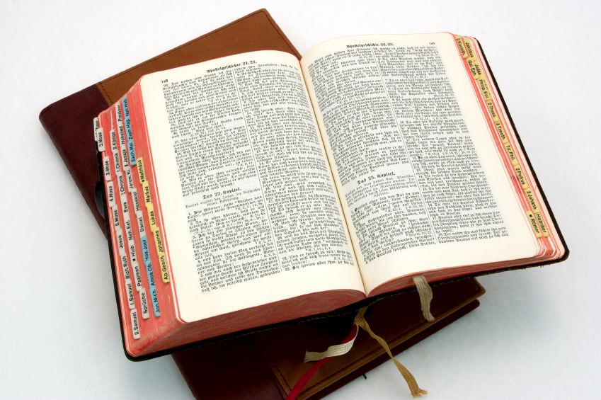
Hear: Romans 10:17
So then faith cometh by hearing, and hearing by the word of God.

Slide 30
Believe: Hebrews 11:6
But without faith it is impossible to please him: for he that cometh to God must believe that he is, and that he is a rewarder of them that diligently seek him.

Slide 31
Repent: Luke 13:3
I tell you, Nay: but, except ye repent, ye shall all likewise perish.

Slide 32
Confess: Matthew 10:32-33
32 Whosoever therefore shall confess me before men, him will I confess also before my Father which is in heaven.
33 But whosoever shall deny me before men, him will I also deny before my Father which is in heaven.

Slide 33
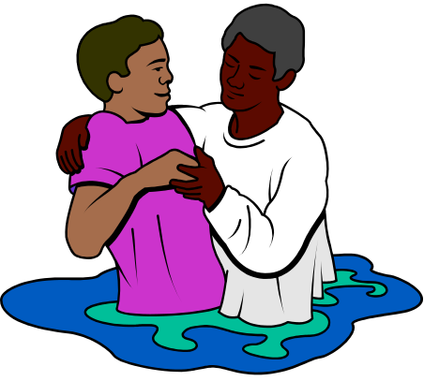
Baptize: Acts 22:16
And now why tarriest thou? arise, and be baptized, and wash away thy sins, calling on the name of the Lord.

